Slide 1

2019
1
Notes:
INFORMATION FOR INSTRUCTORS
Slide notes are intended as aids for delivering and supplementing slide content.
See the “Classes” tab of the ‘Lesson Plans’ worksheet (Google Drive) for the detailed breakdown of slides for each module/part. This includes estimated time (hours) to devote to each slide, with sums at daily and module/part level.
Slide Notes that include a “QUIZ” caption may have animation effects (fly-ins) for displaying the answer after the class has had an opportunity to reply. If present, the number of fly-ins is indicated in a “FLY-INS” caption in the Slide Notes. (See the “Slide Notes” tab of the Google sheet for other captions used.)
Instructors may add slides or content, if required, but should have new material approved before delivery.
Instructors should plan to supplement slide content with whiteboard illustrations and class discussion.
Engaging comprehension checks should be performed frequently. Slide notes contain some suggestions already; instructors should add their own.
Instructors are encouraged to mention practical examples from their own experience and to invite students to do the same.
Most labs have IPython notebook starter files and were developed using Jupyter Notebooks. Other labs have been designed to be executed in an IPython (or other) IDE.
Support should be provided for managing conda environments (command-line and Anaconda Navigator.) Students who choose not to use Anaconda should be competent at managing Python environments by their preferred means.

Slide 2
Data Science and AI
Module 1
Part 1:
Mathematics & Statistics
2

Slide 3
Agenda: Module 1 Part 1
Linear algebra
Calculus
Multivariable calculus
Statistics
Probability
3

Slide 4
What is Linear Algebra and why is it important for Data Science?
Linear Algebra is the branch of mathematics that deals with linear equations and their representations.
Linear Algebra is used extensively in science and engineering to ‘model’ many systems such as in economics, health and finance.
Although many systems are ‘non-linear’, Linear Models can be effective first-order approximation. This is crucial, because non-linear models are very difficult to represent and manipulate.
One excellent way to better understand Linear Algebra is use the geometrical representations of its constructs.
Another way to better understand Linear Algebra is through programming. This is crucial for a Data Scientist.
Key constructs of Linear Algebra are: Scalar, Vector, Matrix and Tensor.
4

Slide 5
Linear Algebra
Vectors
definitions
vector arithmetic (adding, subtracting and multiplying vectors), dot products and cross products
Matrices
definitions
matrix arithmetic
inverses, determinants, transposes
Solving systems of linear equations
Eigenvalues and eigenvectors
5

Slide 6
Mapping and usage of Linear Algebra in Data Science
Concept | Definition | Mapping to Data Science | Examples
Scalar | A ‘zero-dimensional’ dataset. A number, value, magnitude. Geometrically, it’s a point on on a line. | A single data point | Age of a customer
Vector | A one-dimension dataset. A two or more values. Geometrically it represent a vector in a plane that has magnitude and direction. | A number of data points (usually about a single entity) | Attributes (or features) of one customer: Age, income, marital status, postcode, …, etc In Deep Learning a vector could be the input to a Neural Network.
Matrix | A two-dimensional dataset. Geometrically, it represents a transformation of two or more vectors. | A set of observations for multiple entities. A transformation of a dataset from one representation to another. | Information about all customers. In Deep Learning a matrix may represents the mapping and weights on hidden layer.
Tensor | An n-dimensional dataset. | A number of sets of observations | Information about all customers. TensorFlow is built around tensors.
6

Slide 7
Vectors
def: ?
a directed quantity
examples: ?
displacement (not length)
velocity (not speed)
acceleration
force
weight (not mass)
dimensionality > 1
7

Slide 8
Vector Decomposition: 2D
y
v
v_{x} = v cos θ
v_{y} = v sin θ
| v | = (v_{x}² + v_{y}²) ^{1/2}
v_{y}
θ
x
v_{x}
8
Notes:
WHITEBOARD: alt. syntax for vectors (boldface, overhead bar).

Slide 9
Vector Addition
A_{x}
in general:
R_{x} = A_{x} + B_{x}
R_{y} = A_{y} + B_{y}
in this example:
R_{x} = A cos θ + B
R_{y} = A sin θ
θ = tan⁻¹ (R_{y} / R_{x})
A
R
A_{y}
θ
B
B_{x}
9
Notes:
MENTIONS: If A, B are described by components, we don’t need trigonometry to compute R.
QUIZ: (1) Where is Rx? (2) Where is Ry? (3) Can we always eliminate one component (as we did here for By)?

Slide 10
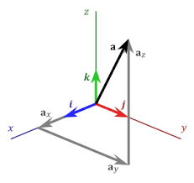
3D Vectors
| a | = (a_{x}² + a_{y}² + a_{z}²) ^{1/2}
Note:
i, j, k are unit vectors
10
Notes:
MENTIONS: (1) A function is a vector with infinite dimensions. (2) Python and R use ‘vector’ to refer to a column of homogenous data.

Slide 11
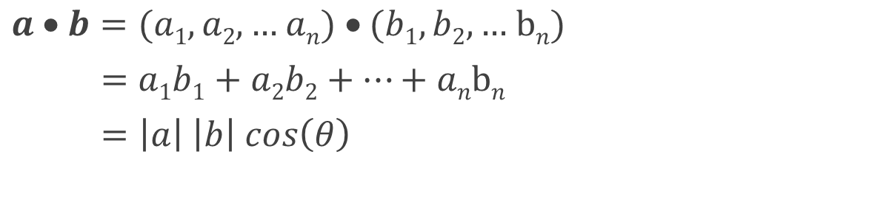
Scalar Multiplication of Vectors
aka inner product, dot product
result is a scalar
11
Notes:
QUIZ: Can we multiply vectors of different length?
MENTION: (1) cos(0) = 1, so parallel vectors have maximum dot product.
(2) cos(90º) = 0, so orthogonal vectors have 0 dot product.
(3) If two vectors represent term frequency in two docs, dot product measures similarity of docs.
A dot product represents the projection of one vector on another.

Slide 12
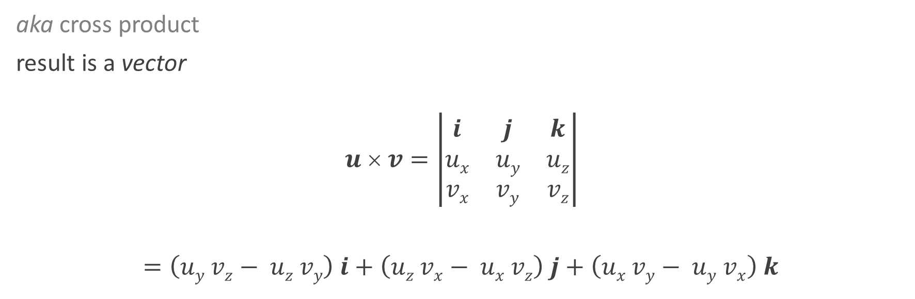
Vector Multiplication of Vectors
12
Notes:
MENTIONS: i, j, k are unit vectors in 3D

Slide 13
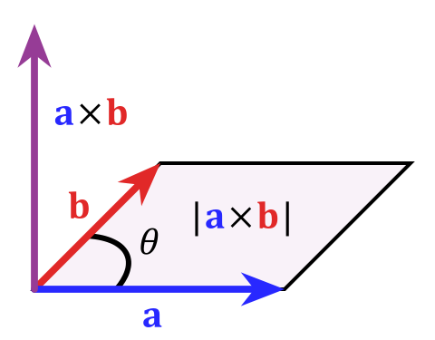
cross product – cont’d
magnitude of a X b
= area of parallelogram
13

Slide 14
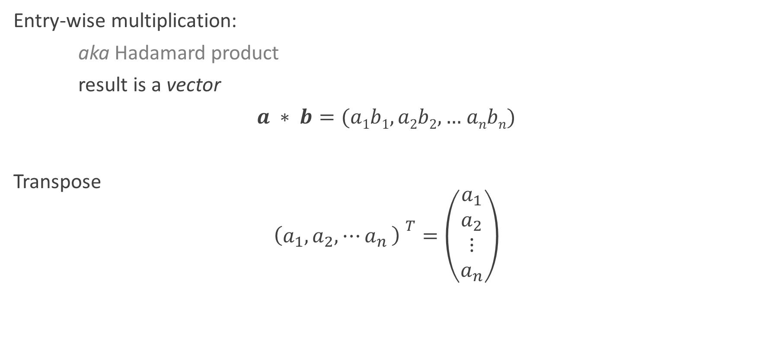
Vector Operations
14

Slide 15
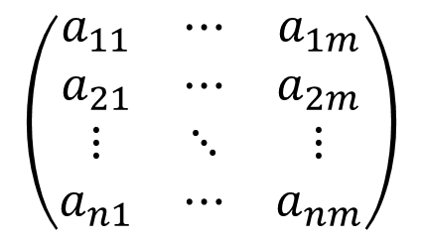
Matrices
def: ?
a rectangular array of numbers
15

Slide 16
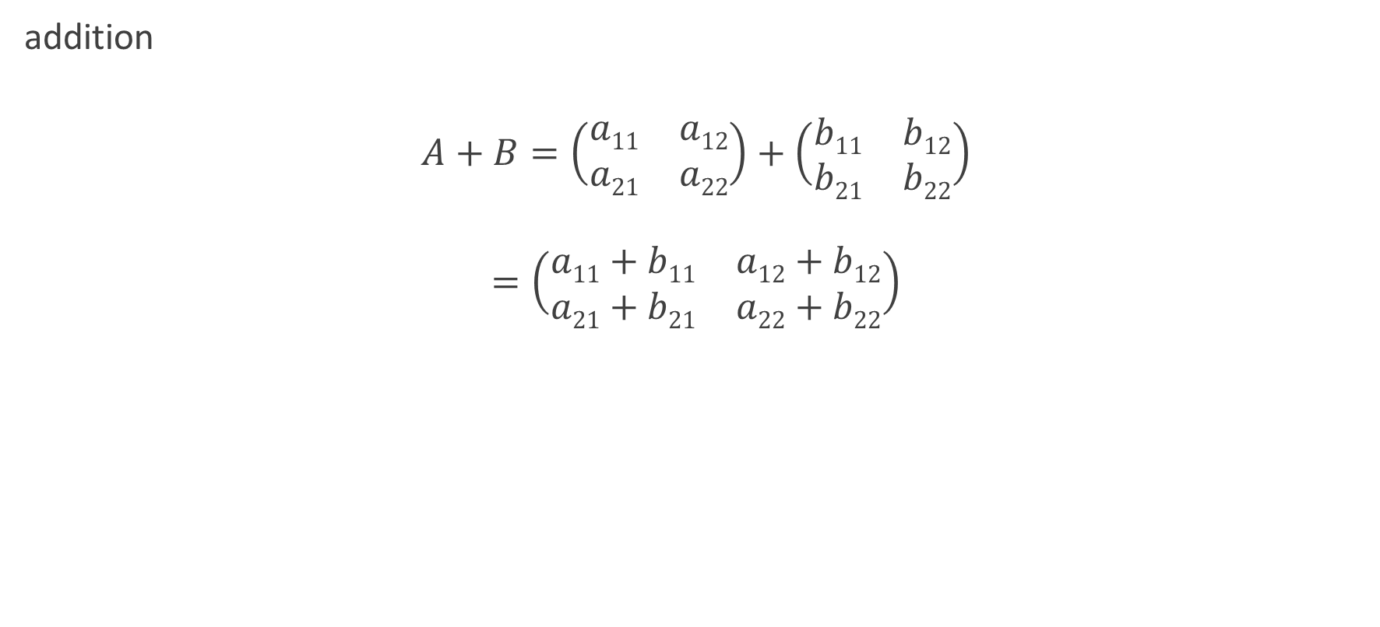
Matrix Arithmetic
16

Slide 17
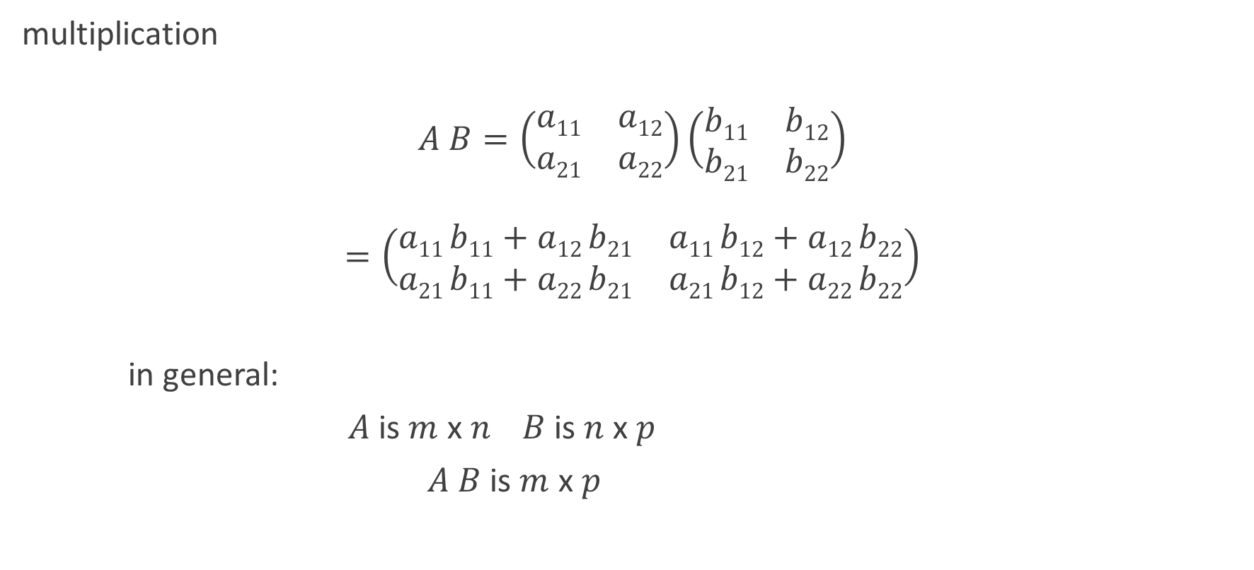
Matrix Arithmetic
17

Slide 18
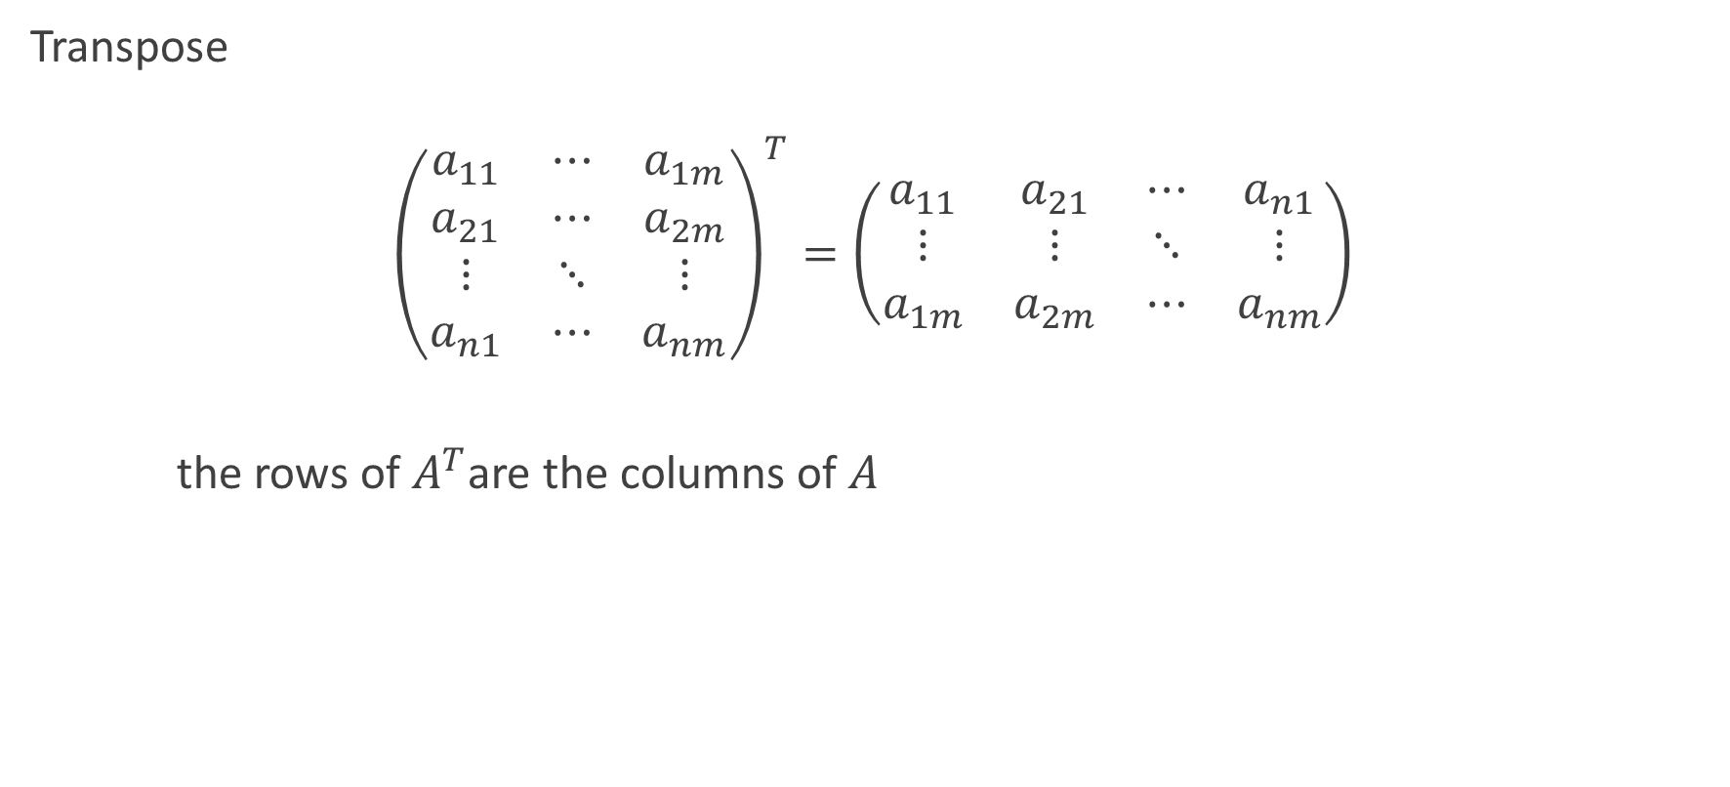
Matrix Operations3
18

Slide 19
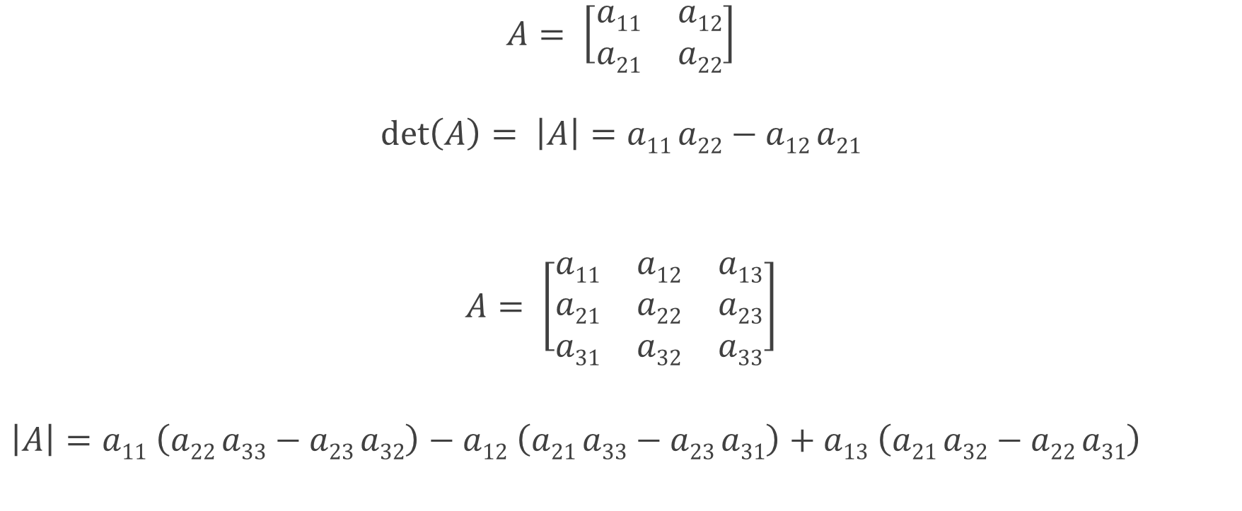
Determinant of a Matrix
19
Notes:
The determinant is useful for solving linear equations, capturing how linear transformation change area or volume, and changing variables in integrals.

Slide 20
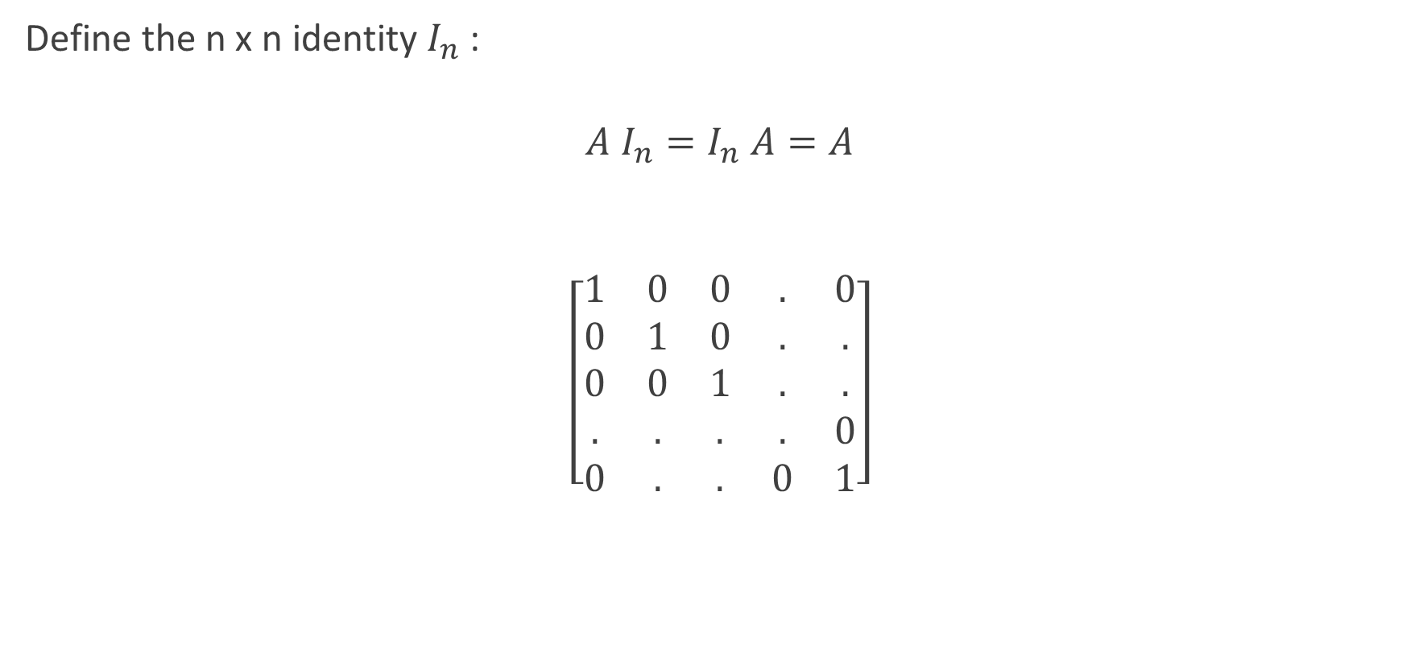
Identity Matrix
20

Slide 21
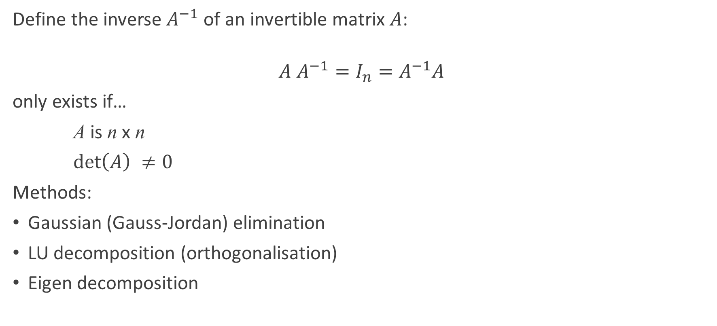
Matrix Inversion
21

Slide 22
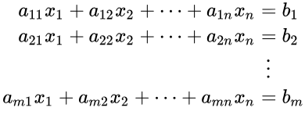
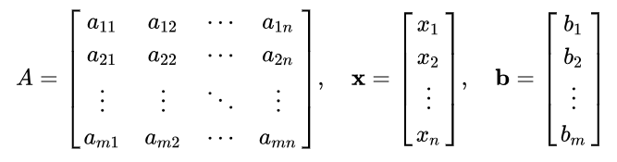

Solving Systems of Linear Equations
Simultaneous linear equations in n unknowns (x_{i}):
in matrix form:
22

Slide 23
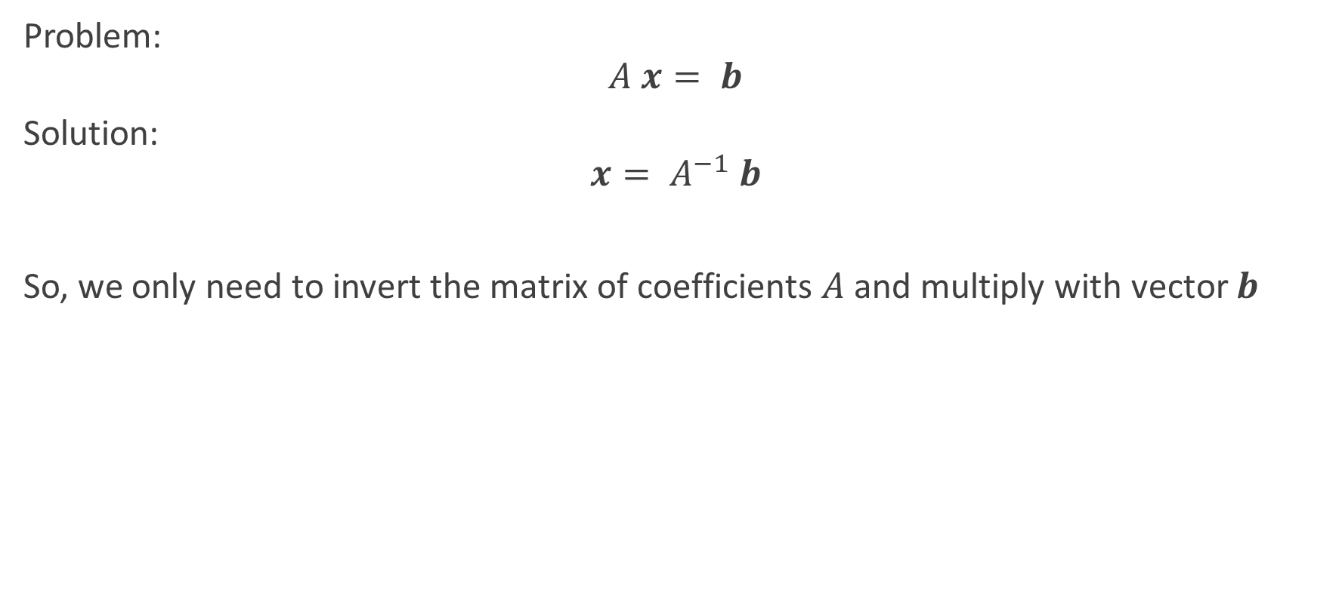
Solving Systems of Linear Equations – cont’d
23

Slide 24
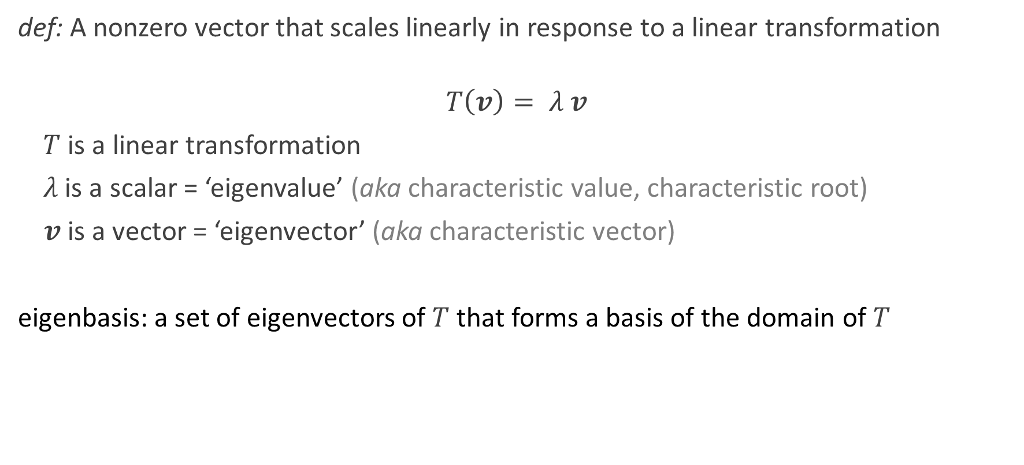
Eigenvalues and Eigenvectors
24

Slide 25
What is bigger than a matrix?
tensor
represented by an n-dimensional array
examples
stress tensor (mechanics)
spacetime tensor (general relativity)
25
Notes:
MENTION: ‘bigger’ = higher order

Slide 26

Lab 1.1.1: Vector and Matrix Operations
Purpose:
To apply the definitions of vector and matrix operations by designing code that implements them.
Materials:
'Lab 1.1.docx’
See Notebook:
‘Lab 1.1 – Notebook – Linear Algebra’
26

Slide 27
Calculus
Limits and continuity
Taking derivatives
Integration
Sequences and series
27

Slide 28
What is Calculus and why is it important for Data Scientists?
Calculus is the mathematical study of continuous change. It is used extensively in many science and engineering domains such as business, economics and medicine.
All key concepts in calculus can be mapped directly to geometrical concepts. For example, differentiation is the slope of a curve and integration is the area under a curve.
Calculus is usually used with linear algebra to find the "best fit" linear approximation for a set of points in a domain. Therefore it is essential for Data Science as it underpins all model optimisation.
28

Slide 29
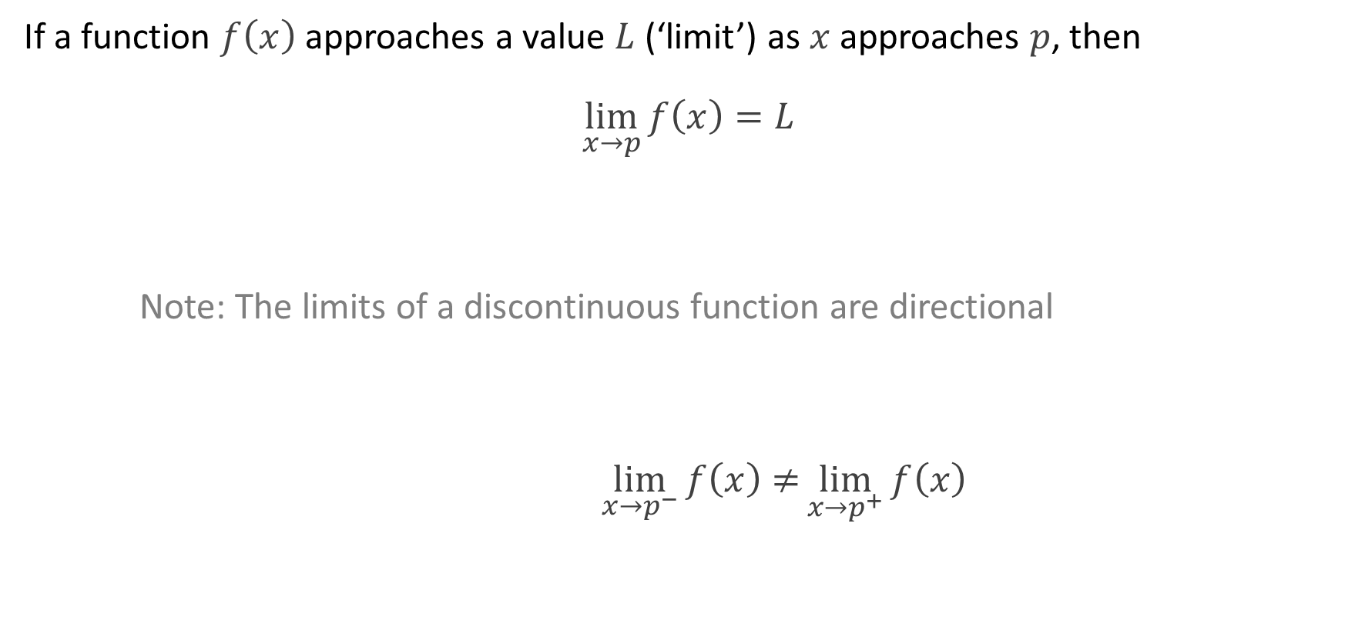
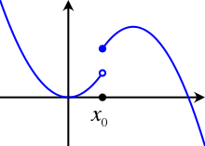

Limits and Continuity
29

Slide 30
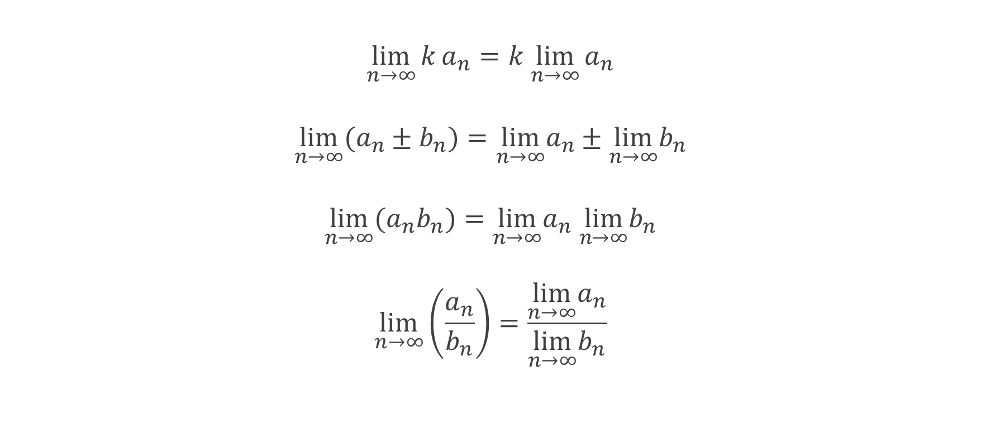
Limit Theorems
30

Slide 31
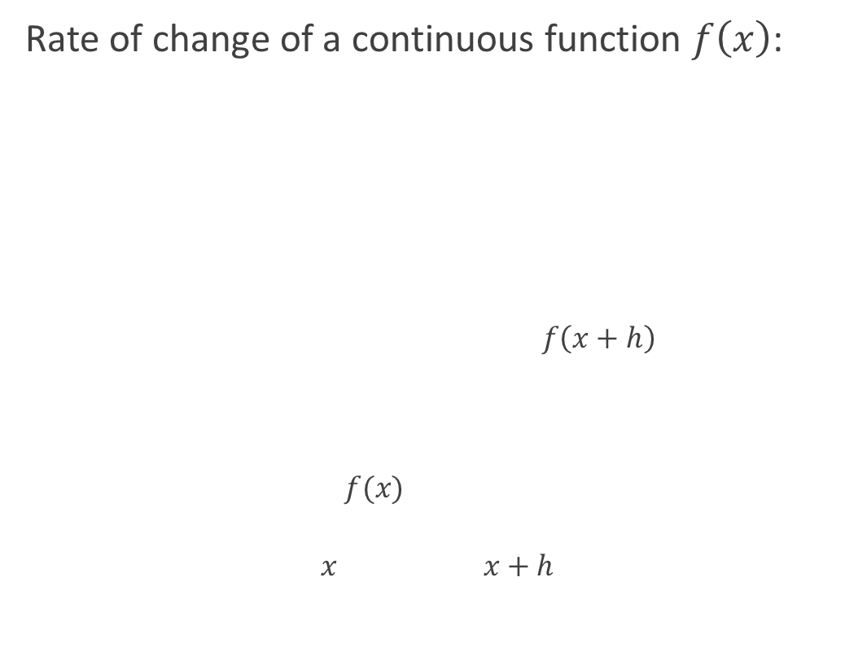
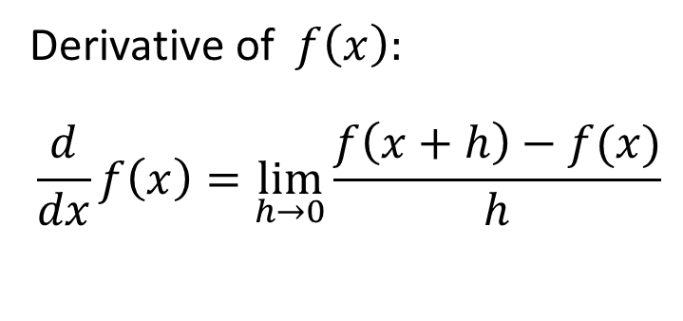
Differentiation
31

Slide 32
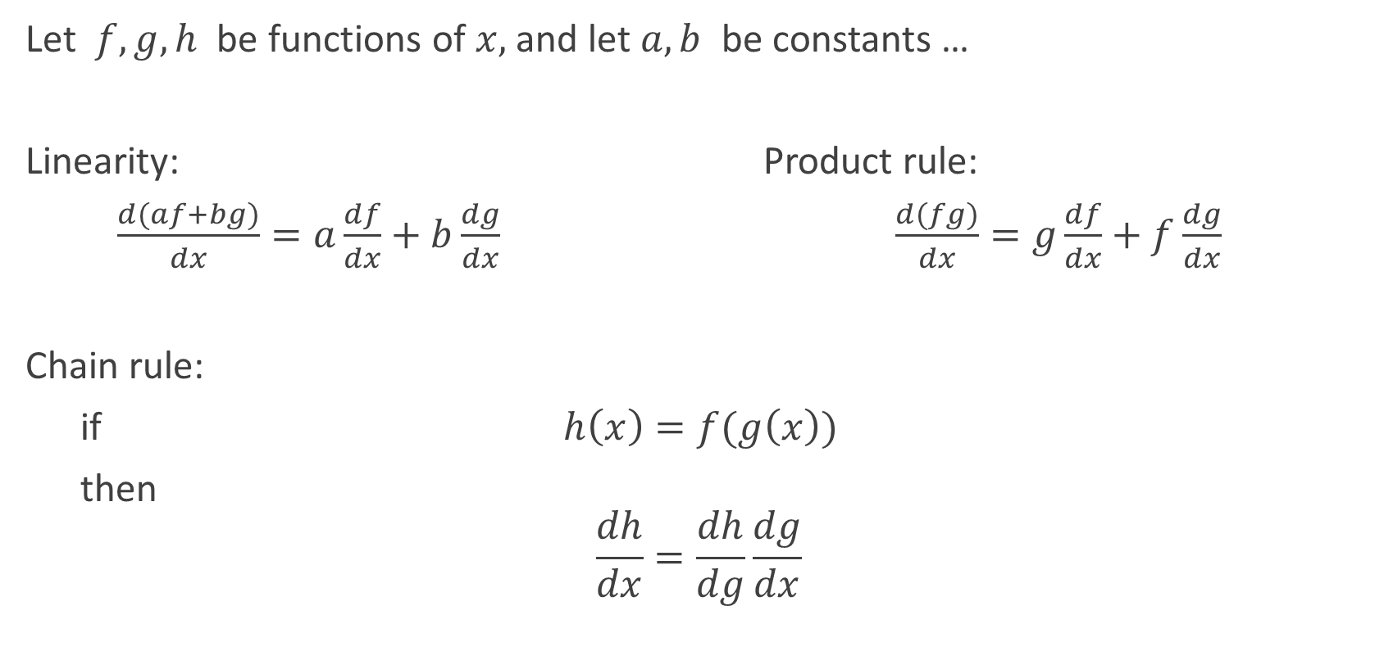
Rules of Differentiation
32

Slide 33
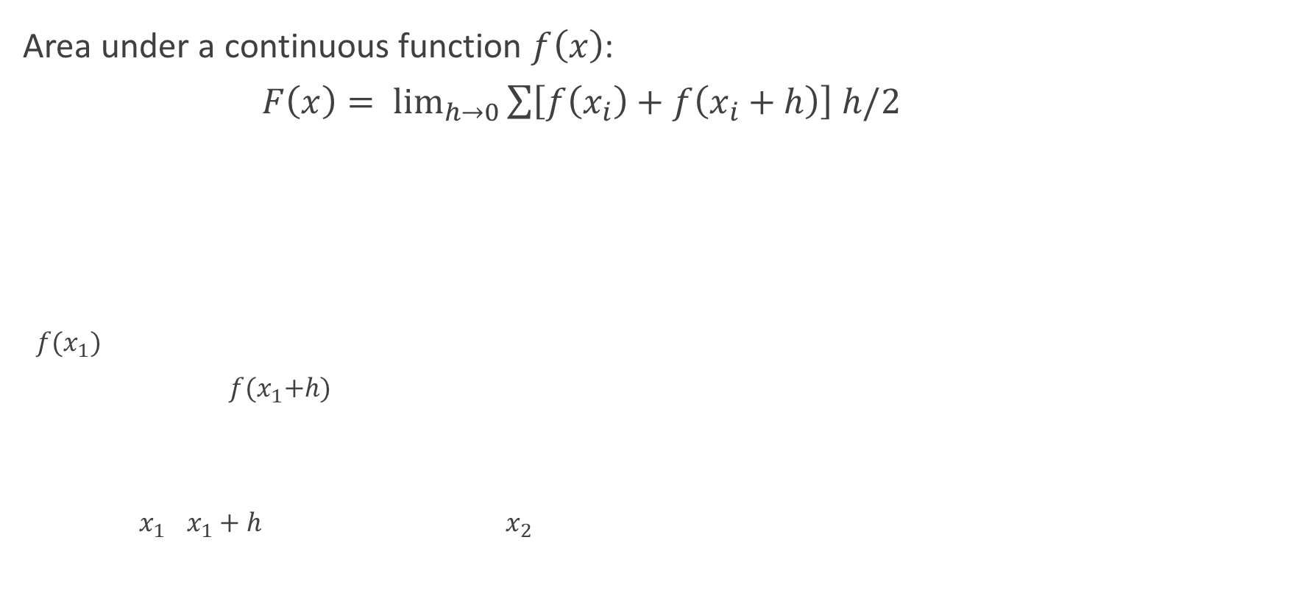
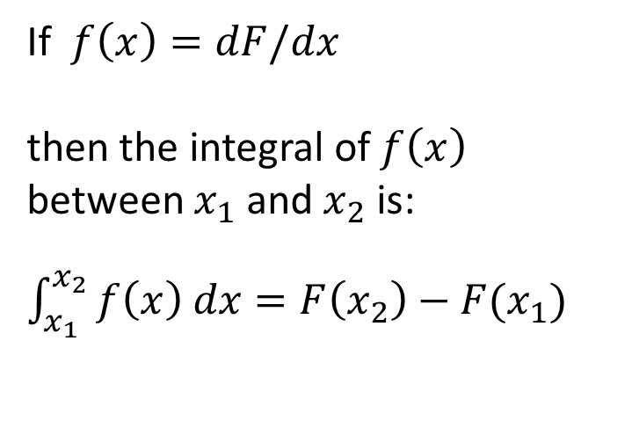
Integration
33

Slide 34
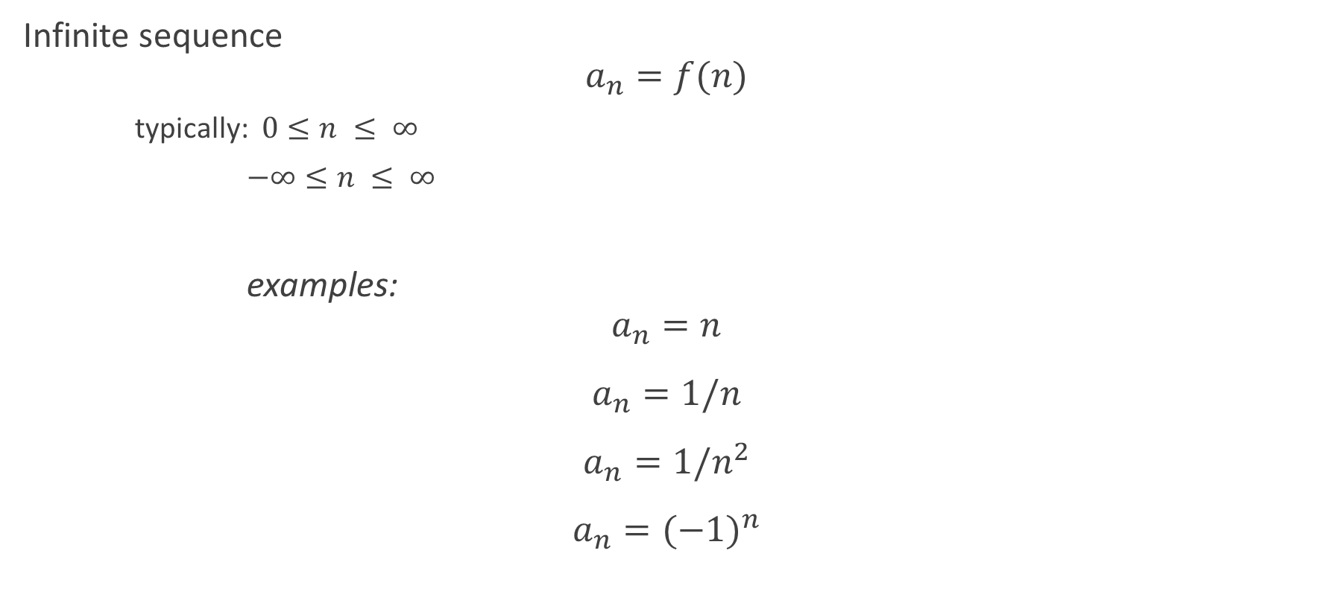
Sequences and Series
34

Slide 35
Multivariate Calculus
Partial derivatives
Multivariate differentiation
Multivariate integration
Optimising multivariate functions
35

Slide 36
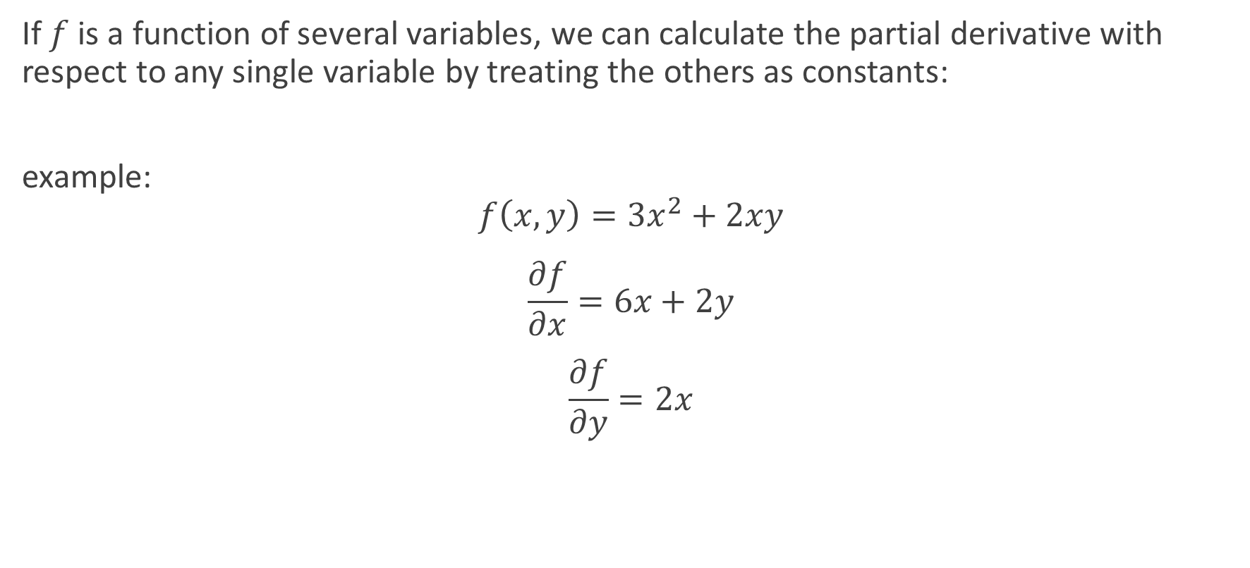
Partial Derivatives
36

Slide 37
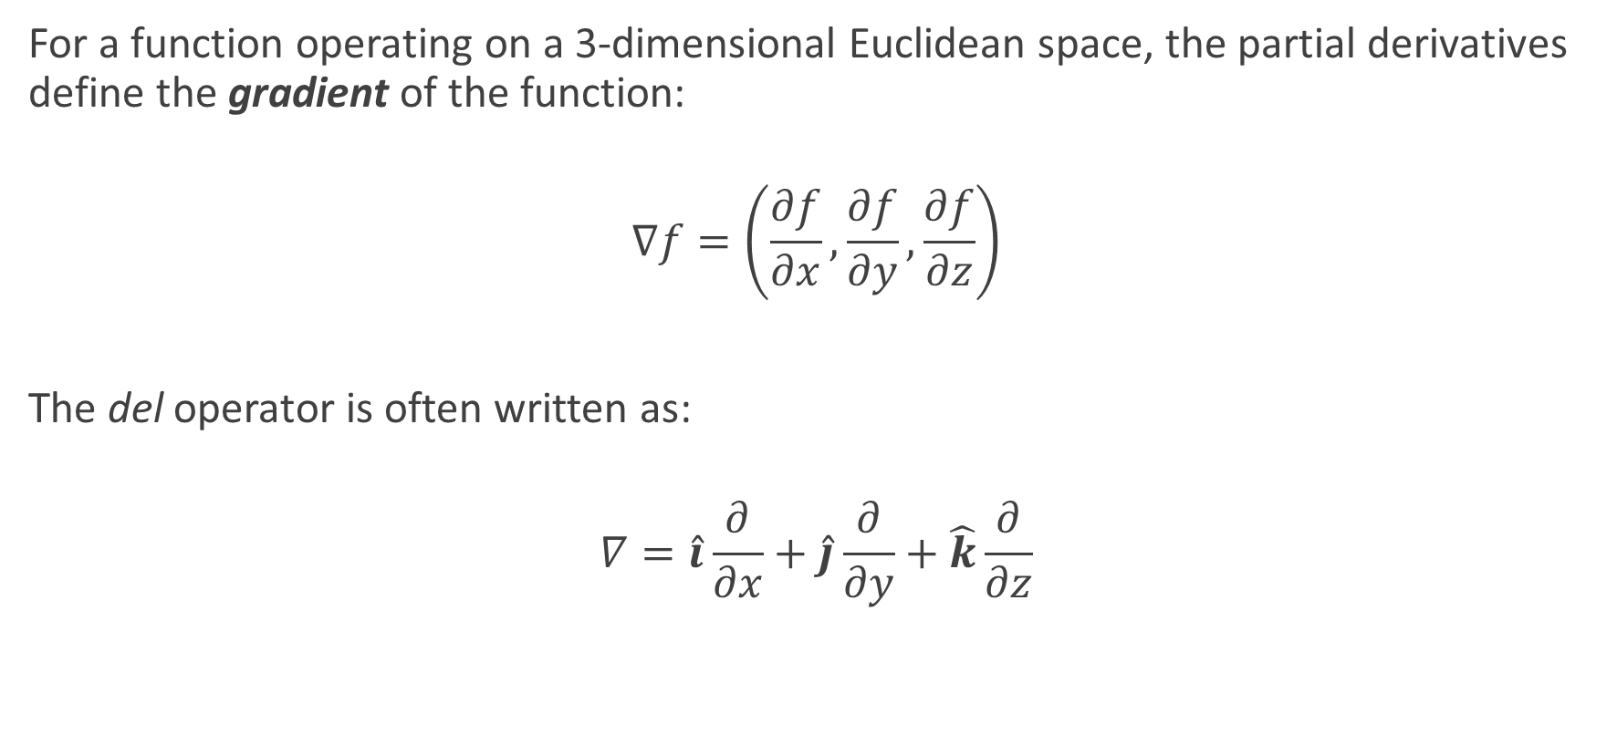
Partial Derivatives – cont’d
37

Slide 38
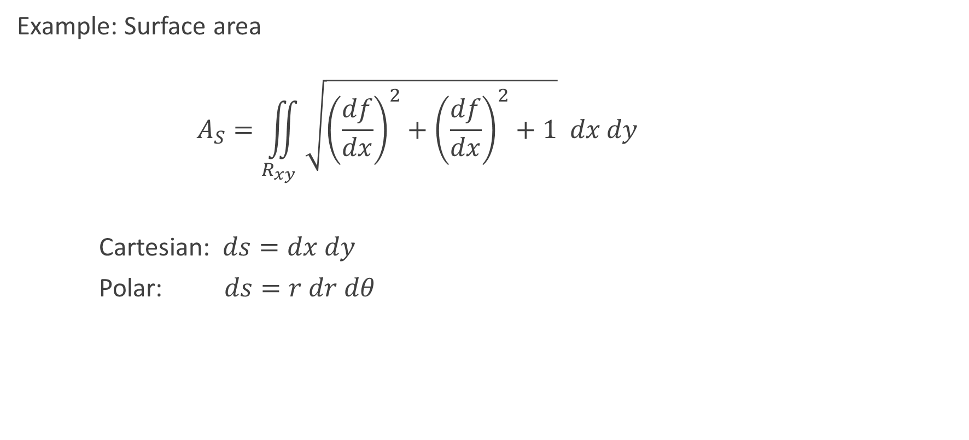
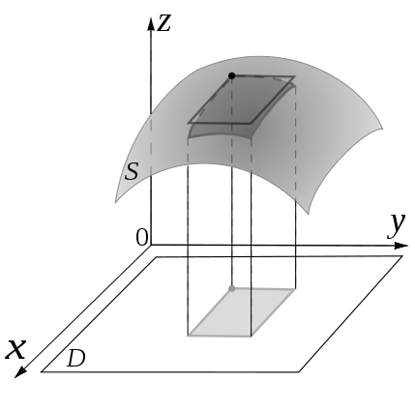
Multivariate Integration
38

Slide 39
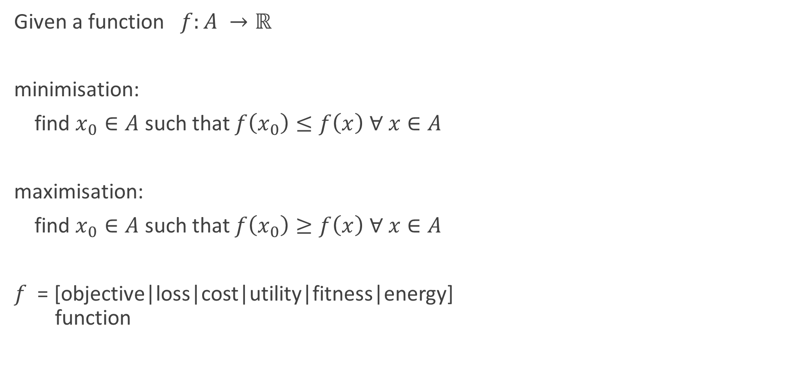
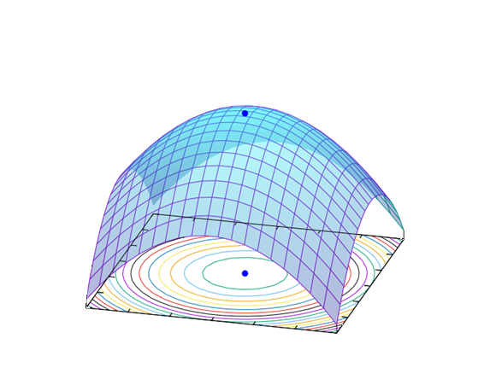
Multivariate Optimisation
39

Slide 40
Lab 1.1.2: Differentiation and integration in Python
Purpose:
Use python to define limits, derivative and integral of a function (for example, f(x) = x**2).
Materials:
See Notebooks
Calculus - Limits
Calculus – Derivative
Calculus – Integral
Note:
There may not be enough time to complete this lab in the class.
Please complete it as a part of you homework.
This should apply to all labs.
40

Slide 41
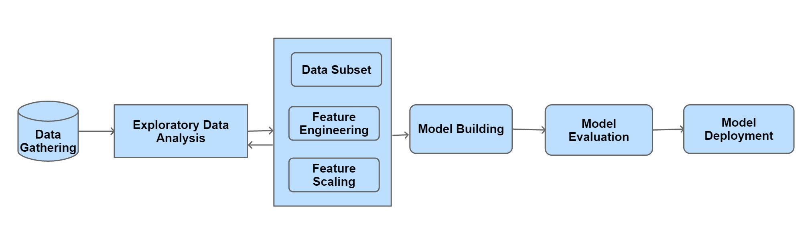
Discussion
Why do data scientists need to be proficient at calculus, infinite series, and linear algebra?
Considering the illustrative Data Science process, where would you use calculus?
41

Slide 42

Homework: Optimisation
Purpose:
To introduce several methods of multivariate optimisation via working examples.
Materials:
An Interactive Tutorial on Numerical Optimization
https://www.benfrederickson.com/numerical-optimization/
Prepare to discuss:
trade-off: convergence speed vs accuracy
faster convergence requires lower resolution
prefer methods with adaptive resolution
42

Slide 43
Statistics
Statistical Thinking
Categorical data
Continuous variables
Summarising quantitative data
Modelling data distributions
Confidence intervals
Significance tests and hypothesis testing
Statistical Inference
Analysing one categorical variable
Two-way tables: Analysing categorical data
Distributions in two-way tables
43

Slide 44
Why statistics is important for a Data Scientist?
Statistical Thinking is an an essential component of a data-driven mindset which is crucial for a Data Scientist
Statistical analysis must start with the appropriate data (sample)
Statistical Inference (reasoning) should start with measurement, ideally, via controlled experiments
Statistics uses samples (a small subset of the population) and therefore always has a degree of uncertainty
Sampling must be random, and preferably, independent
The best way to learn statistics is by experimenting with data using Python code and visualisation
44

Slide 45
Statistics – Part 1
Analysing categorical data
Analysing one categorical variable
Two-way tables: Analysing categorical data
Distributions in two-way tables
45

Slide 46
Categorical Variables
Examples
FALSE / TRUE (alt: 0 / 1)
colour
size
class
e.g. species, occupation, degree program, disease category
tier
e.g. age range, income range, frequency range
46

Slide 47
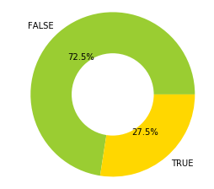
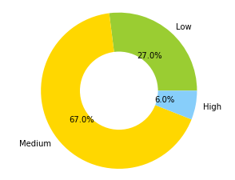
Analysing Categorical Variables
Frequency Tables (aka contingency tables)
category incidence for a single variable within a population
Donut Charts
Income Bracket
Low | 0.27
Medium | 0.67
High | 0.06
Passed Exam
FALSE | 37
TRUE | 14
47

Slide 48
Analysing Categorical Variables – cont’d
Two-Way Frequency Tables
for a Single Variable within Two Populations
totals row, column: marginal frequencies (aka marginal distribution)
Income Bracket: | Low | Medium | High | Total
Male | 27 | 75 | 6 | 108
Female | 32 | 59 | 3 | 94
TOTAL | 59 | 134 | 9 | 202
48

Slide 49
Analysing Categorical Variables – cont’d
Dummy Variables (aka dummy coding)
allows categorical variables to be treated like continuous variables
Passed Exam
0 | 37
1 | 14
Treatment | T1 | T2
Control | 0 | 0
Drug 1 | 1 | 0
Drug 2 | 0 | 1
49

Slide 50
Statistics – Part 2
Continuous variables
Summarising quantitative data
Measuring centre in quantitative data: mean, mode, and median
Interquartile range (IQR)
Variance and standard deviation of a population
50

Slide 51
Continuous Variables
Examples
height
dose
temperature
concentration
revenue
clicks
“Continuous”?
variability is treated as infinite
precision is determined by data acquisition methodology
range usually has practical limits
outliers can be defined statistically or heuristically
frequency (contingency) is not meaningful
51

Slide 52
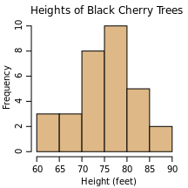
Analysing Continuous Variables
Distribution of binned data:
choose an appropriate bin width
‘cut’ the data into bins
count the number of samples that fall into each bin
what is the resulting plot called?
histogram
52

Slide 53
Summarising Quantitative Data
Measuring the centre of the data
mean
the average value of the variable
median
the value that separates the 50% lowest values from the rest
mode
the most frequently occurring value
53

Slide 54
Summarising Quantitative Data – cont’d
Quantiles
inverse of binning data for a histogram:
specify proportions of samples we want in each bin
compute bin boundaries that correspond
example: 4 quantiles from a random sample (mean = 0, variance = 1):
Quantile | Boundaries | Count
(0 - 0.25] | (-3.135, -1.61] | 53
(0.25 - 0.50] | (-1.61, -0.0913] | 389
(0.50 - 0.75] | (-0.0913, 1.427] | 476
(0.75 - 1.0] | (1.427, 2.946] | 82
54

Slide 55
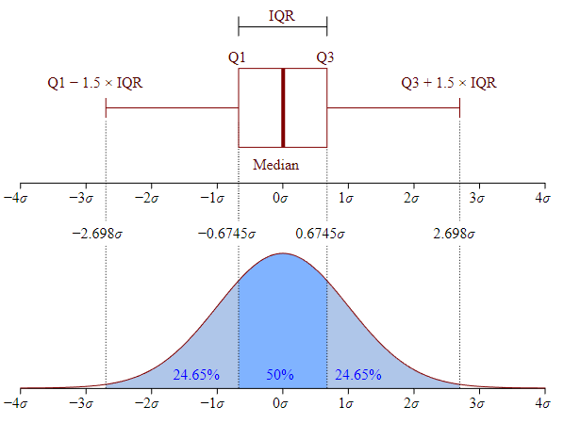
Summarising Quantitative Data – cont’d
Interquartile range (IQR)
IQR = [0.25, 0.75]
box plots are drawn with whiskers extending 1.5 IQR beyond the 0.25 and 0.75 quantiles (i.e. the 1st and 3rd quartiles)
outliers are typically defined as lying outside this range
By Jhguch at en.wikipedia, CC BY-SA 2.5, https://commons.wikimedia.org/w/index.php?curid=14524285
55

Slide 56
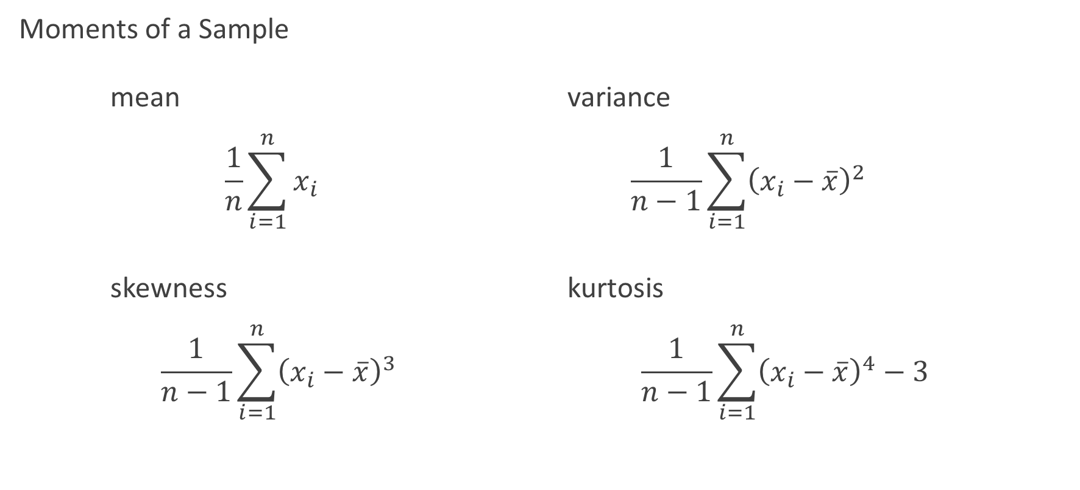
Summarising Quantitative Data – cont’d
56
Notes:
In

Slide 57

Lab 1.1.3: Simple data visualisation
Purpose:
Use various plot types to visualise statistical observations.
Materials:
Notebook: ‘Statistics – part 1’
Note:
There may not be enough time to complete this lab in the class.
Please complete it as a part of you homework.
This should apply to all labs.
57

Slide 58
Statistics – Part 3
Modelling data distributions
Percentiles
Z-scores
Density curves
Normal distributions
58
Notes:
WEEK 1, DAY 3, PART 1

Slide 59
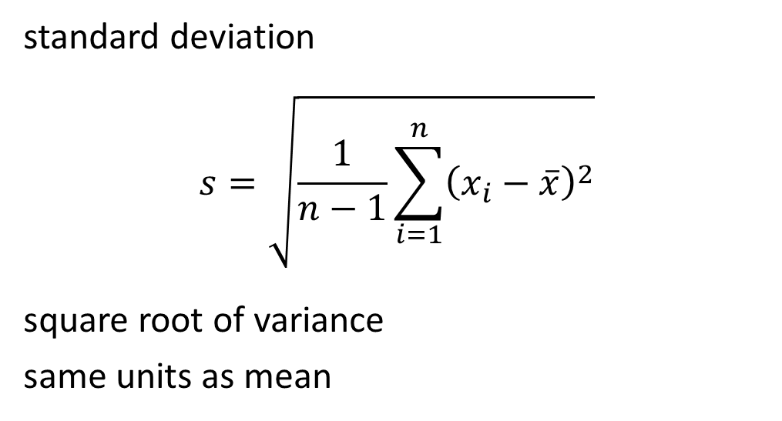
Summarising Quantitative Data – cont’d
Summary statistics
59

Slide 60
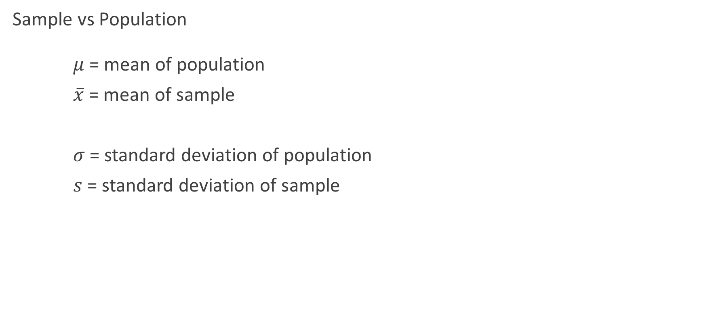
Modelling Data Distributions
60

Slide 61
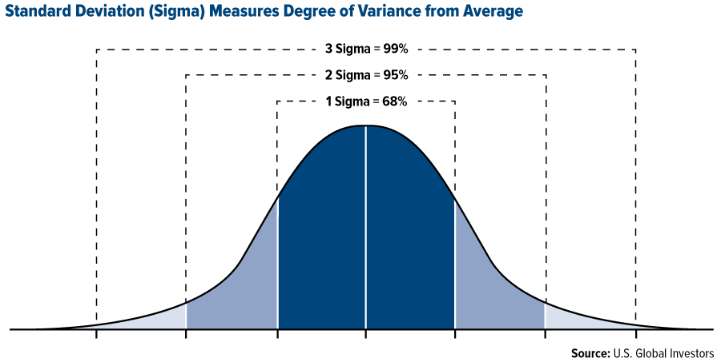
Modelling Data Distributions – cont’d
Mean and Standard Deviation of a Population
Variation
61

Slide 62
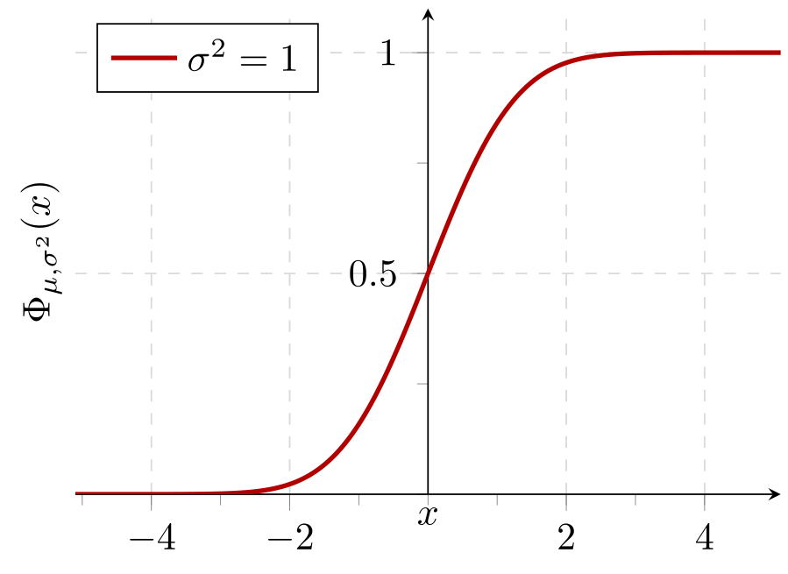
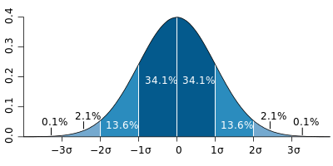
Modelling Data Distributions – cont’d
Probability Density Function Cumulative Probability
By M. W. Toews - Own work, based (in concept) on figure by Jeremy Kemp, on 2005-02-09, CC BY 2.5, https://commons.wikimedia.org/w/index.php?curid=1903871
62

Slide 63
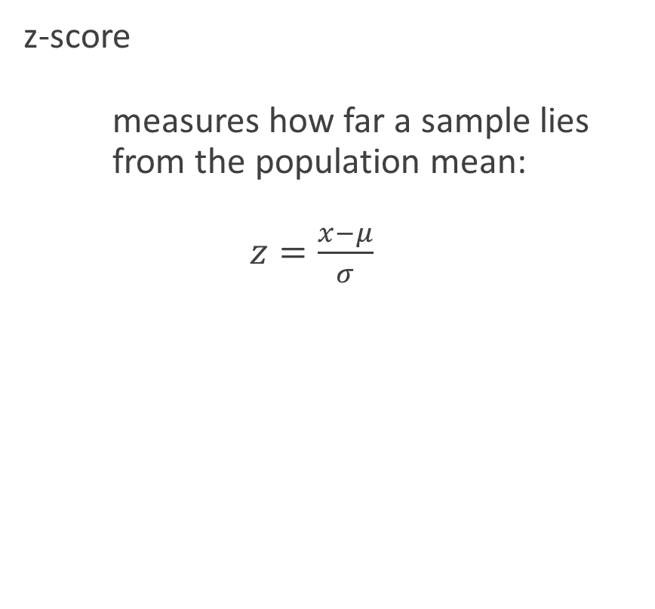
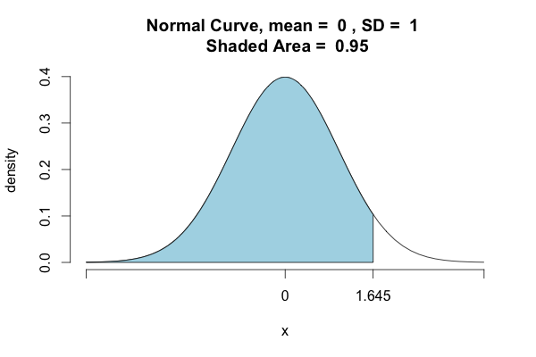
Modelling Data Distributions – cont’d
63
Notes:
JOKE: As opposed to the ZZZ-score, which measures how boring the lecture is.

Slide 64
Statistics – Part 4
Exploring bivariate numerical data
Scatterplots
Correlation coefficients
Trend lines
Least-squares regression equations
Assessing the fit in least-squares regression
64

Slide 65
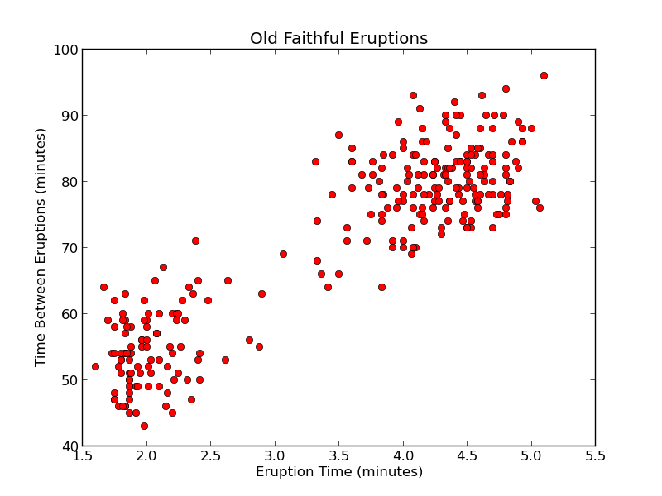
Scatter Plots
2D: plots one variable against another
demonstrates a relation (or lack thereof) between two variables
assumption: data pairs are sampled simultaneously
65

Slide 66
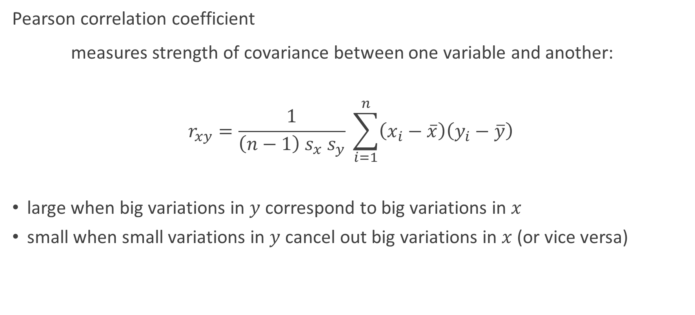
Correlation
66

Slide 67
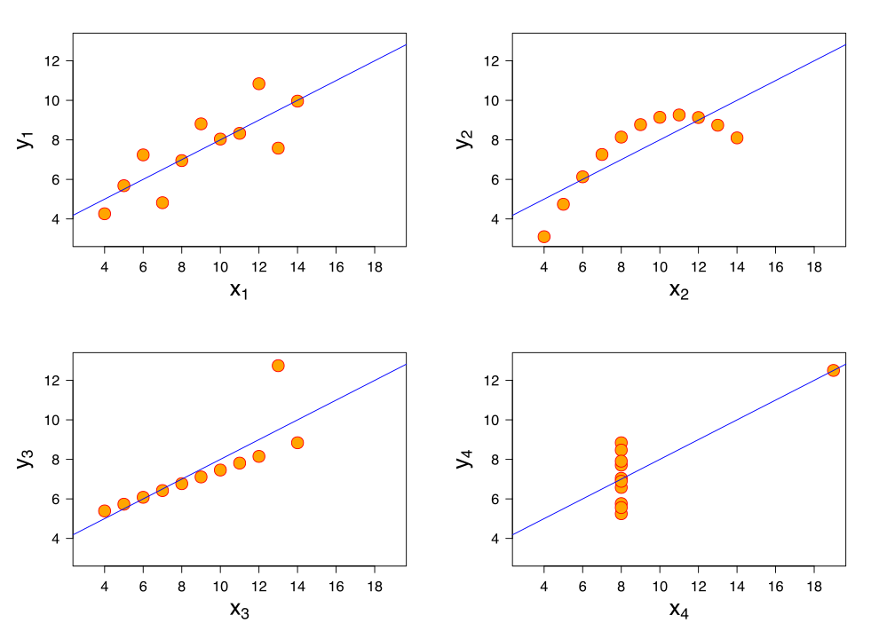
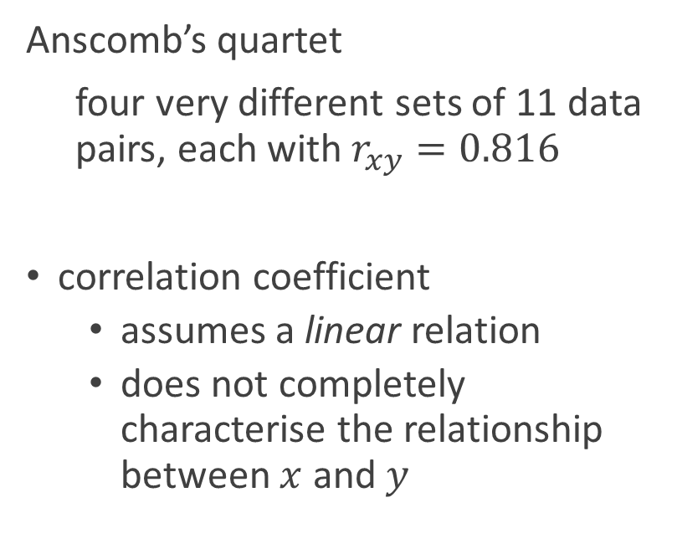
Correlation
By Anscombe.svg: SchutzDerivative works of this file:(label using subscripts): Avenue - Anscombe.svg, CC BY-SA 3.0, https://commons.wikimedia.org/w/index.php?curid=9838454
67

Slide 68
Trend Lines
best (linear) fit to a 2D scatter plot
the line that minimises error by some criterion
line is specified by
slope
intercept
By Anscombe.svg: SchutzDerivative works of this file:(label using subscripts): Avenue - Anscombe.svg, CC BY-SA 3.0, https://commons.wikimedia.org/w/index.php?curid=9838454
68

Slide 69
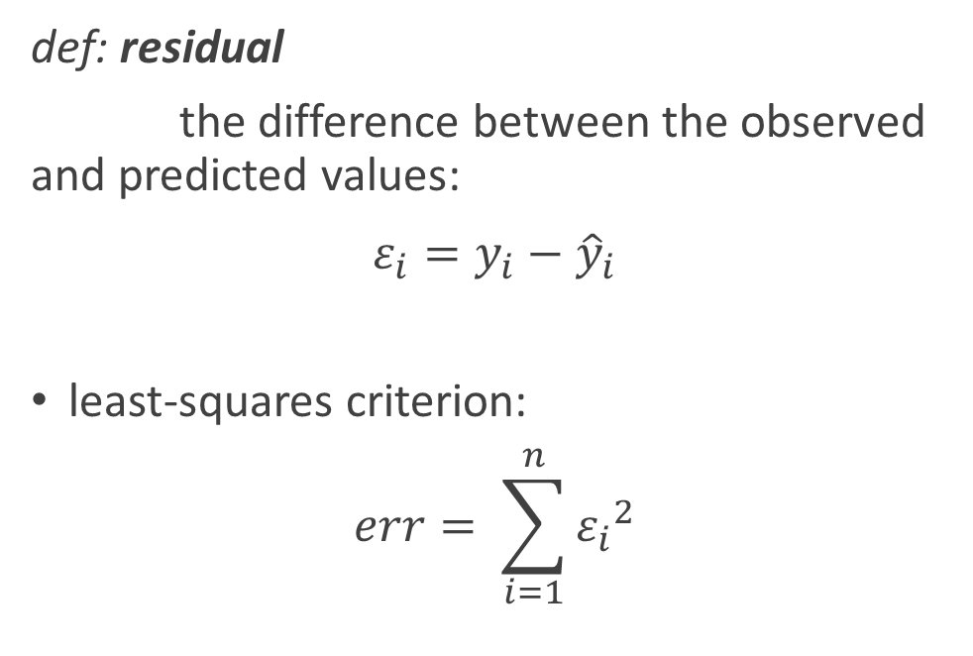
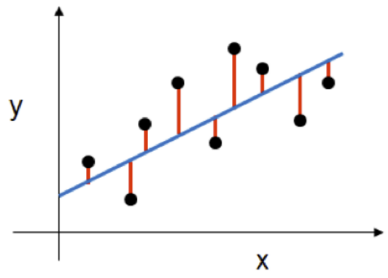
Least-Squares Regression
69

Slide 70


Least-Squares Regression
70

Slide 71
Statistics – Part 5
Random variables
Discrete random variables
Continuous random variables
Transforming random variables
Combining random variables
Binomial random variables, mean and standard deviation formulas
Geometric random variables
Poisson distribution
The central limit theorem
71

Slide 72

Random Variables
72
Notes:
A discrete variable is a variable whose value is obtained by counting. A discrete random variable X has a countable number of possible values.
Examples: number of students present. number of red marbles in a jar
A continuous variable is a variable whose value is obtained by measuring.
Examples: height of students in class, weight of students in class
A random variable is a variable whose value is a numerical outcome of a random phenomenon.

Slide 73

Transforming random variables
73

Slide 74

Transforming random variables – cont’d
74

Slide 75

Transforming random variables – cont’d
75

Slide 76



Normal Distribution
77
By Inductiveload - self-made, Mathematica, Inkscape, Public Domain, https://commons.wikimedia.org/w/index.php?curid=3817954
Notes:
Probability Distribution Function
MENTION: CDF is the integral of PDF.

Slide 77
Other types of Probability Distributions
Bernoulli distribution
The outcome of a single Bernoulli trial (e.g. success/failure, yes/no)
Binomial distribution
The number of "positive occurrences" (e.g. successes, yes votes, etc.) given a fixed total number of independent occurrences
Geometric distribution
Binomial-type observations where the quantity of interest is the number of failures before the first success; a special case of the negative binomial distribution
78

Slide 78
Statistics – Part 6
Confidence intervals
Significance tests and hypothesis testing
Inference
ANOVA
79

Slide 79


p-Value
80

Slide 80

Confidence Intervals
mean ± | % population
1 σ | 68.2
2 σ | 95.4
3 σ | 99.7
81

Slide 81
Confidence Intervals – cont’d
We define confidence intervals in terms of target probability bands:
confidence interval | mean ± | p-value
0.68 | ∼1 σ | 0.32
0.95 | ∼2 σ | 0.05
0.99 | ∼3 σ | 0.01
82

Slide 82

Significance Tests
83
Notes:
MENTION: (1) +/- 1 SD covers 68.2% of population; 2 covers 95.4%, 3 covers 99.7%.

Slide 83


One-Tailed Test vs Two-Tailed Test
One-tailed test: is B greater than A?
a 95% confidence interval would mean we are interested in the last 5% of the right tail
Nb. for “Is B less than A” we would be looking at the left tail instead of the right.
Two-tailed test: is B different from A?
a 95% confidence interval would mean we are interested in the last 2.5% of each tail
standard normal distribution
84

Slide 84

Standard Error of the Mean
85

Slide 85

Student’s t-Test
86
Notes:
MENTION: We apply the t-test in the same way as the z-test, but we get smaller confidence intervals.

Slide 86
Null Hypothesis
If we want to test whether B is different from A, we first assume that it is not.
Then we test to see if the difference between A and B is likely to occur by random chance.
If the difference between A and B exceeds the confidence interval, we reject the null hypothesis, and infer that B is not from the same population.
87
Notes:
The null hypothesis is the hypothesis that there is no significant difference between specified populations, any observed difference being due to sampling or experimental error.

Slide 87
ANOVA (Analysis of variance)
for comparing multiple groups, repeated application of the t-test would randomly give rise to apparent significance
ANOVA avoids this error by introducing the F-test (analogous to the t-test but for more than 2 groups)
You can use SciPy to estimate variations between two or more groups
88

Slide 88
Probability
Basic theoretical probability
Bayesian inference
Probability using sample spaces
Basic set operations
Permutations and combinations
Conditional probability and independence
89

Slide 89

Probability
90

Slide 90

Sample Space
91

Slide 91






Set Operations
92

Slide 92

Permutations and Combinations
93

Slide 93
Bayes’ inference theorem
Bayes’ inference theorem is used to update the probability for a hypothesis as more evidence or information becomes available.
Theorem:
P(H|E) = P(E|H).P(H)/P(E)
Definition:
P(A|B): The probability of a event A given B
94

Slide 94
Bayesian versus Frequentist reasoning
A Bayesian defines a "probability" as an indication of the plausibility of a proposition or a situation.
A Frequentist is someone that believes probabilities represent long run frequencies with which events occur or has occurred.
The main critique of Bayesian inference is that a subjective prior is, well, subjective.
The defence is that the probability of hypotheses is exactly what we need to make decisions.
94

Slide 95
Lab 1.1.4: Applying statistical thinking using Python
Purpose:
Explore how to use Python (and related packages) to apply Statistical Thinking on data.
Materials:
Notebook: ‘Statistics – part 2’
Note:
The may not be enough time to complete this lab in the class.
Please complete it as a part of you homework.
This should apply to all labs.
95

Slide 96

Homework
Install Anaconda (for Python 3.7) on your laptop
Please share your experience (success or problems) with the team on the course Slack channel
Apply for a Twitter Developer Account
96

Slide 97
Questions?
97

Slide 98
End of presentation
98

